Slide 1
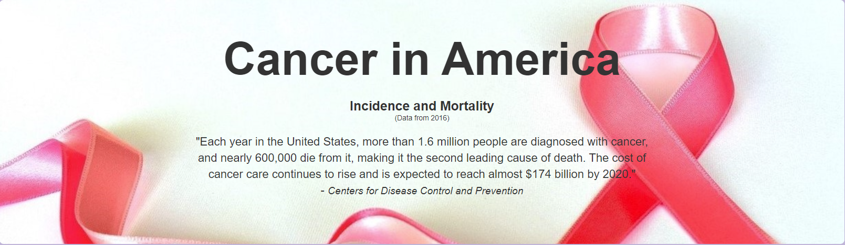
Cancer Data Visualization Project
Kristi McGrath, Todd Auman & Bobby Huffstetler

Slide 2
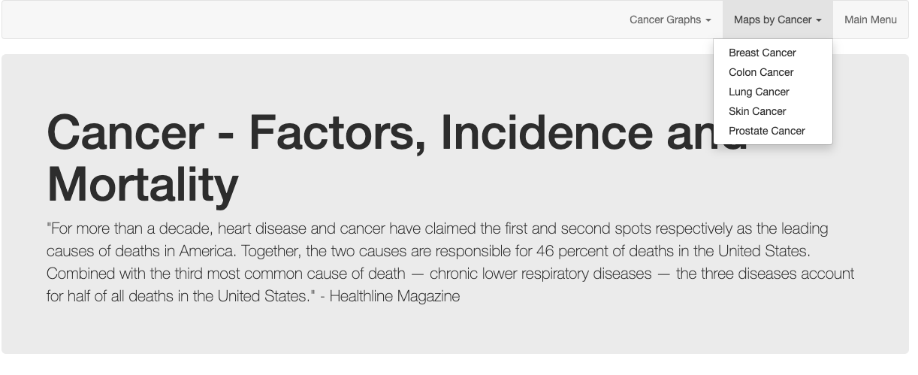
In the beginning …

Slide 3
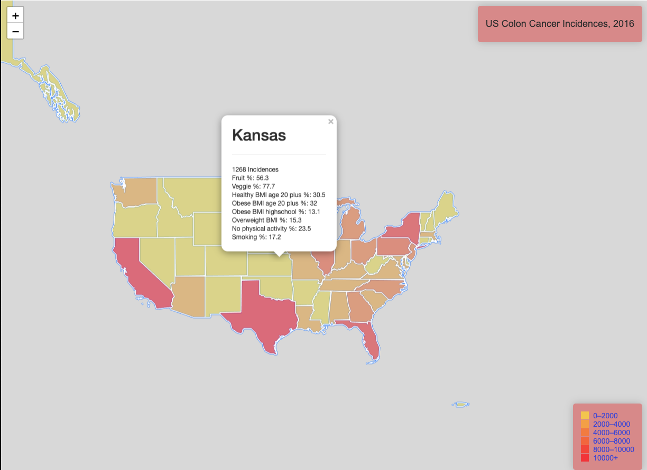

Slide 4
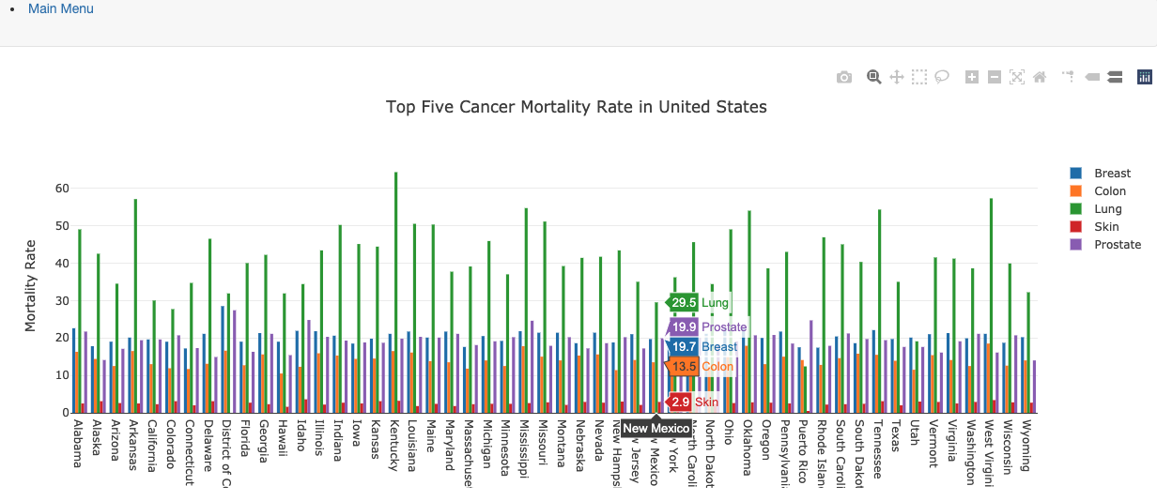
Tons of data … too busy

Slide 5
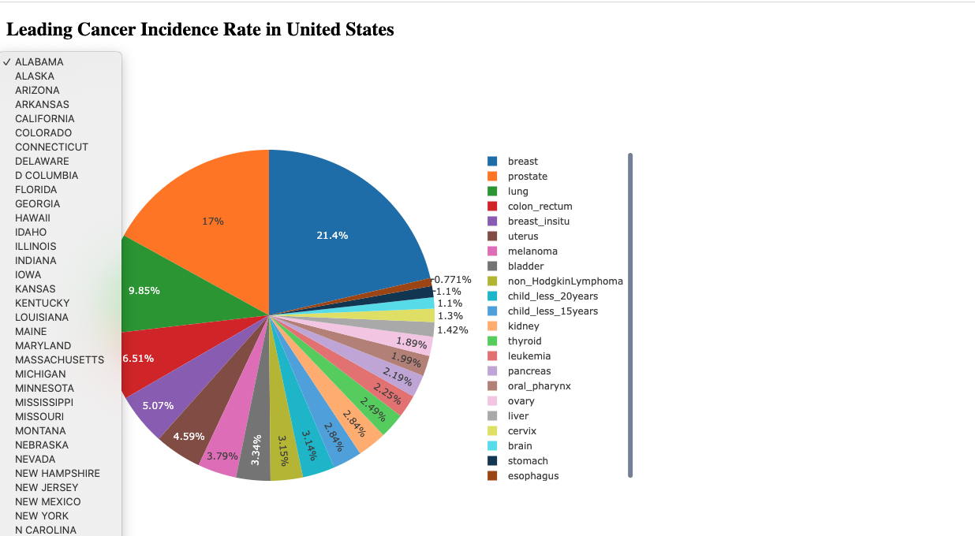
All 50 States and 22 different cancers … still too busy

Slide 6
Kristi

Slide 7
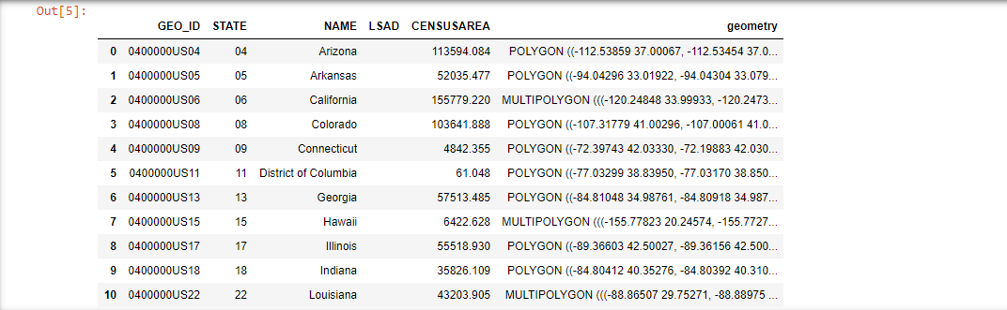
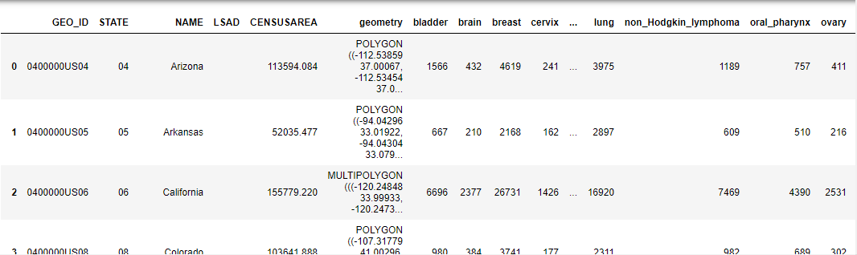
Data ETL
Original GeoJSON file with state borders
State GeoJSON data*, incidence.csv and mortality.csv files read into Pandas
Data transformed to retain desired columns and rows
Incidence data merged into GeoJSON dataframe and wrote to a GeoJSON file
Mortality data written as JSON file
GeoJSON file merged with state cancer incidence data
*imported geopandas library to handle geojson file

Slide 8
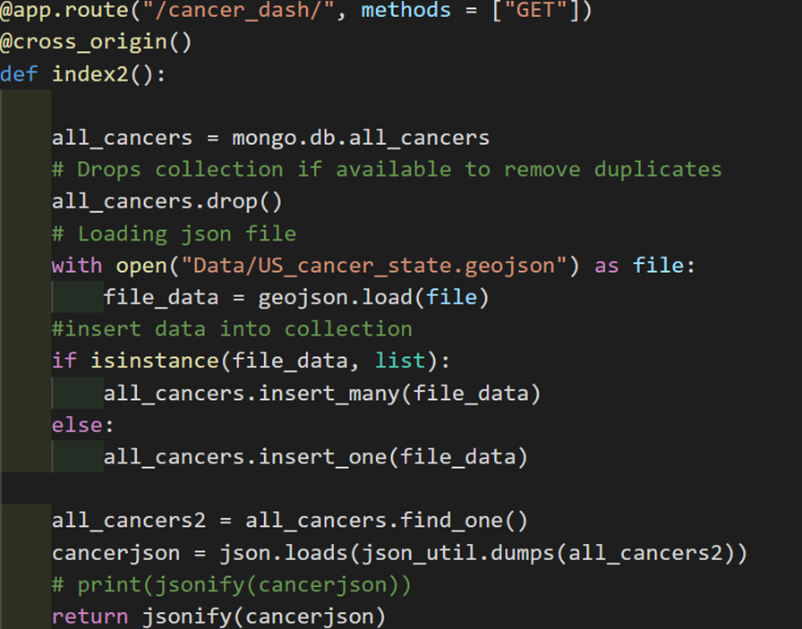
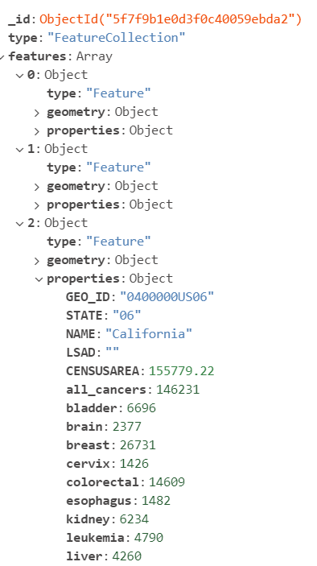
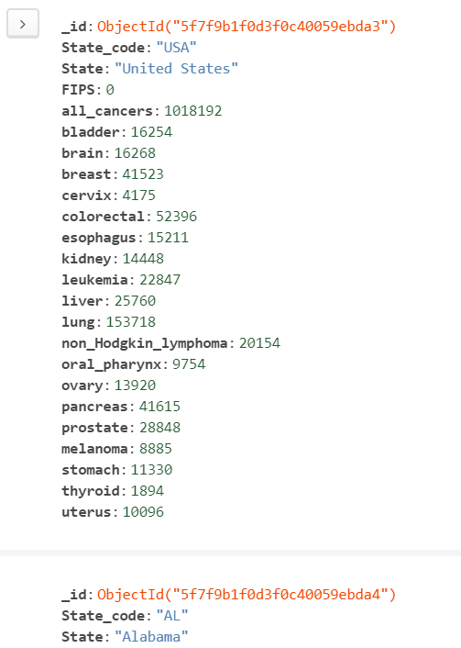
Restful API route to load data into MongoDB
GeoJSON – single document
Mortality – multiple documents
*In addition, Flask was used to web scrape a current cancer news article from cancer.gov, send this information to MongoDB, and render it on our page.

Slide 9
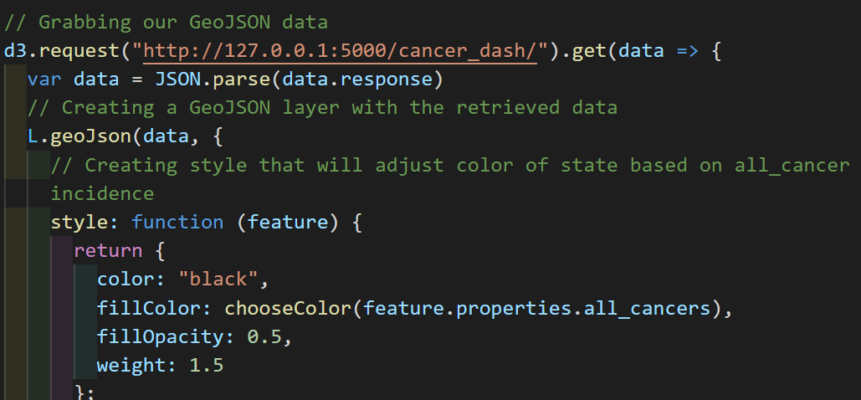
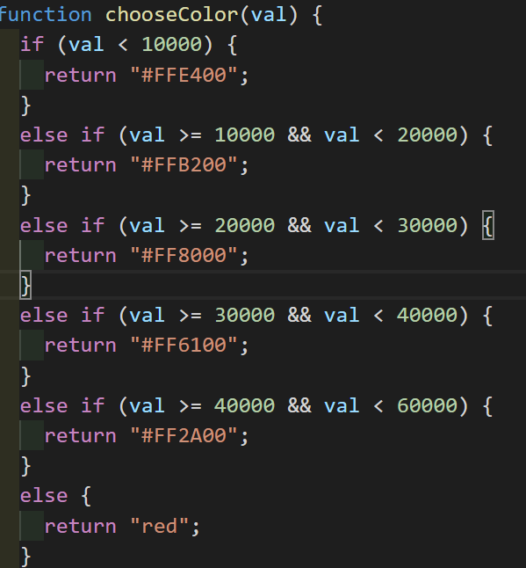
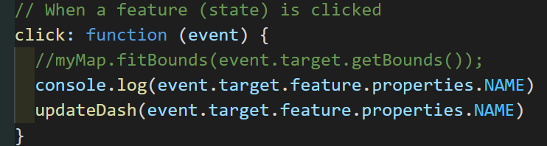
Map Layer
coloring map on incidence

Slide 10
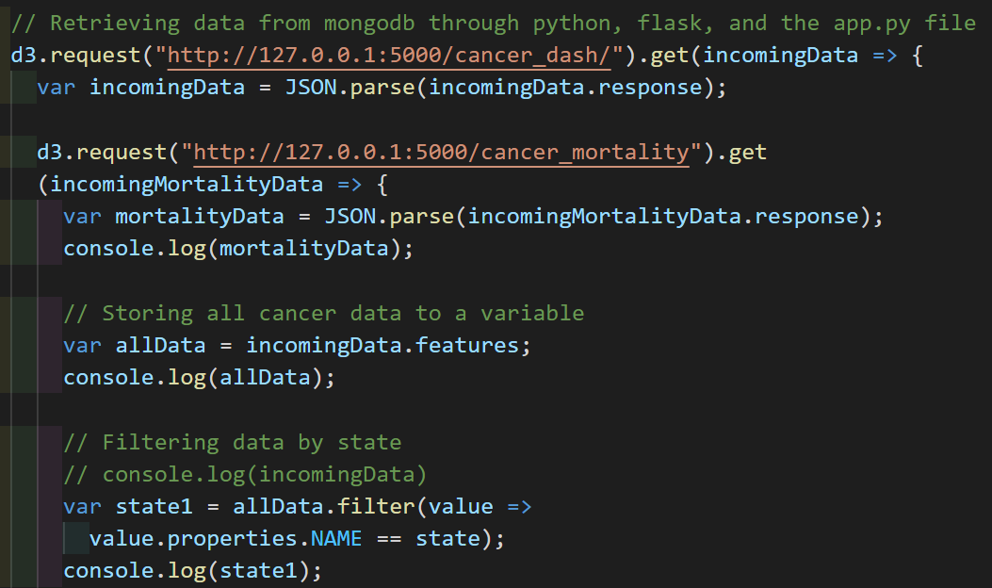
Retrieving data when a state is selected
Filter data files on state selected
Sort Incidence data and slice to get top 5 values
Create lists of labels and values
Top 5 cancers
All cancers
Loop through mortality data to get values associated with Incidence labels

Slide 11
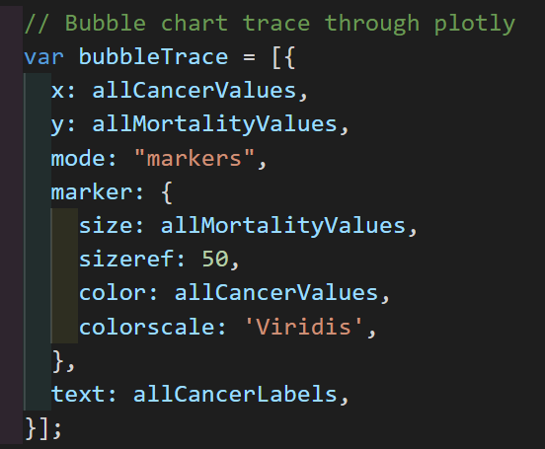
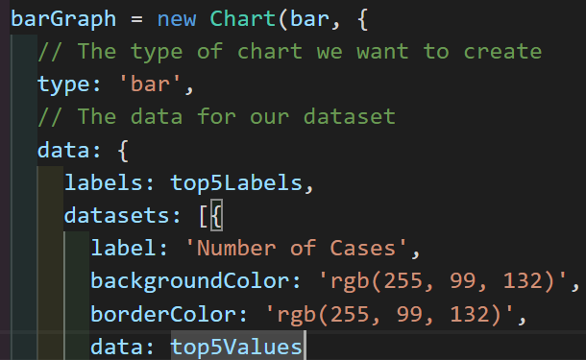
Individual State Graphs
Used the JavaScript library chart.js to create:
bar chart
doughnut chart
radar chart
polar chart
Used the JavaScript library plotly.js to create:
bubble chart

Slide 12

Our Final Product….

Slide 13
Some Challenges:
Loading data into MongoDB through flask
Connecting web scraping to interactive dashboard
Chart.js

Slide 14
Sources:
https://statecancerprofiles.cancer.gov/
https://www.cancer.gov/research/resources/resource/130
https://www.cancer.gov/news-events
https://www.cdc.gov/cancer/uscs/dataviz/download_data.htm
https://wonder.cdc.gov/
https://eric.clst.org/tech/usgeojson/

Slide 15

Questions?

